Slide 1
Studies in Multicultural Societies
Different Peoples,
One World
  Multiculturalism and Sustainable Tourism
Hari Srinivas
Room: I-312 / 079-565-7406

Slide 2
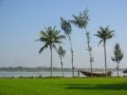
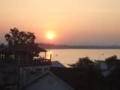
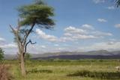
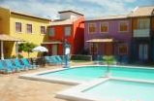
Global Tourism
World’s largest service industry (UNWTO)
2008: 922 million outbound travellers spending
over $856 billion
Employs approximately 10% of global workforce
Forecast: to grow 3-5% per annum until 2020
In 2020, international tourist arrivals is estimated to reach 1.6 billion tourists worldwide
International tourism generated a worldwide revenue of US$ 856 billion or 30% of world exports

Slide 3
Global Tourism
Forty-fold increase
from 1950 to 2000
Tripling in
two decades

Slide 4
Basic Tourism concepts
Tourism arises from the movement of people to, and their stay in, various destinations
There are two elements in all tourism; the journey to the destination and the stay including activities at the destination;
The journey and the stay take place outside the normal place of residence and work, so that tourism gives rise to other activities as well

Slide 5
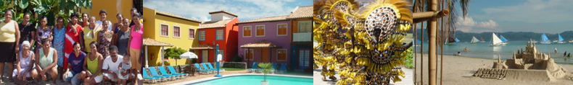
Tourism Sector
Tourism provides a wide range of economic opportunities, especially for developing and least developed countries:
Transport, communications, infrastructure, education, security, health, immigration, customs, accommodation, agriculture and creative industries

Slide 6
Tourism Value Chain
Hotels
Hotels/Lodges/camps/etc.
Food & Beverages
Restaurants,
Markets, Wholesalers, retailers
Producers, farmers
Transportation
Regional & Local
Bus, taxi, car rental, etc.
Souvenirs
Souvenir shops, markets, sellers
Craftsmen, local producers
Excursions
Guides, tour operators, travel agencies, etc.

Slide 7
Tourism links
LINKING ARTISTS TO TOURISM MARKETS
LINKING AGRICULTURAL SECTOR TO TOURISM MARKETS
ECOLOGY MANAGEMENT AND CLIMATE CHANGE
LINKING THE HANDICRAFT SECTOR TO TOURISM MARKETS
BUILDING LOCAL CAPACITY FOR THE TOURISM JOB MARKET
LINKING BUSINESS SECTORS TO TOURISM MARKETS

Slide 8
Sustainable Tourism
UNSUSTAINABLE TOURISM:
  • Overcrowding
  • Lower quality of experience
  • Loss of distinctiveness
  • Erosion of culture and
  environment
SUSTAINABLE TOURISM:
Do no harm, and celebrate the Place

Slide 9
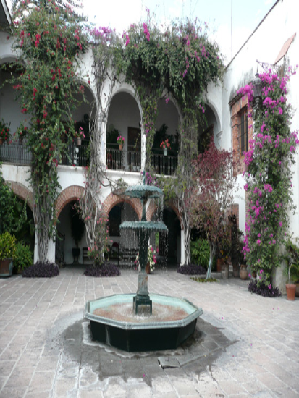
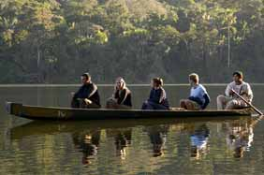
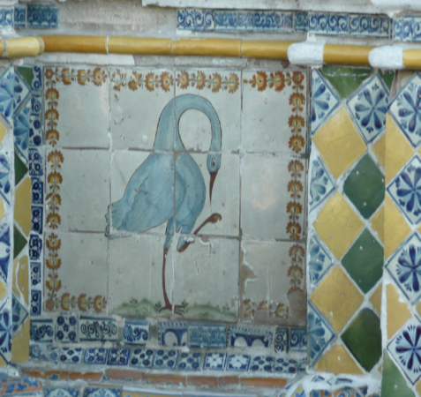

Sustainability Trends in Tourism
  Rising consumer interest: 84% of Expedia customers interested in sustainable hotels and willing to pay 5% more;
  In a recent Travelocity survey, 59 percent of respondents stated a “green” rating would have at least some influence in their hotel selection;
  Increasingly governmental programs and new regulations are favoring sustainable tourism;
  Rise in media attention to issues of sustainability and tourism.

Slide 10

Increased awareness on Sustainability
Rio Earth Summit, 1992
Agenda 21 for the Travel and Tourism Sector, 1995
UN CSD-7, 1999
World Summit on Sustainable Development, 2002
International Year of
Ecotourism, 2002

Slide 11

Sustainable Tourism
Sightseeing
Cultural tourism
SUSTAINABLE
Local cuisine
TOURISM
ECOTOURISM:
nature
Heritage tourism
Agri-
tourism
Indigenous tourism

Slide 12
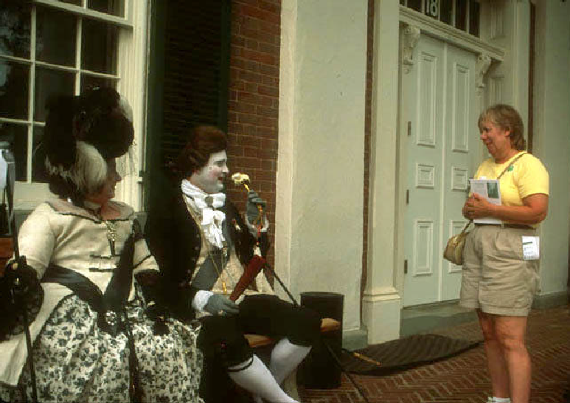
HISTORY

Slide 13
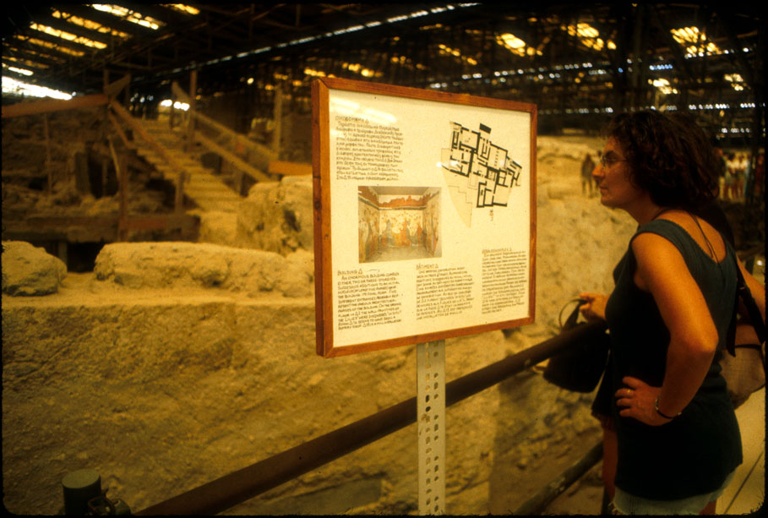
ARCHAEOLOGY

Slide 14
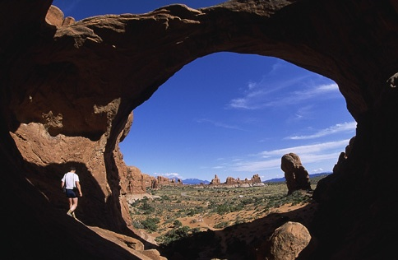
GEOLOGY
Notes:
Incidentally, you may hear geologists use “geotourism” to mean “geological tourism”—a very narrow niche!—but one that still falls within the broader, geographical definition.

Slide 15
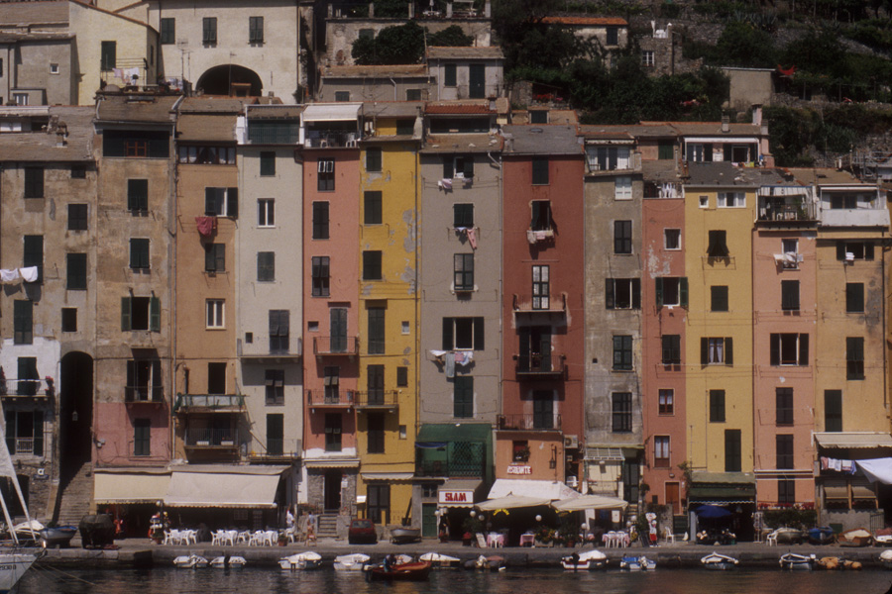
TRADITIONAL ARCHITECTURE

Slide 16
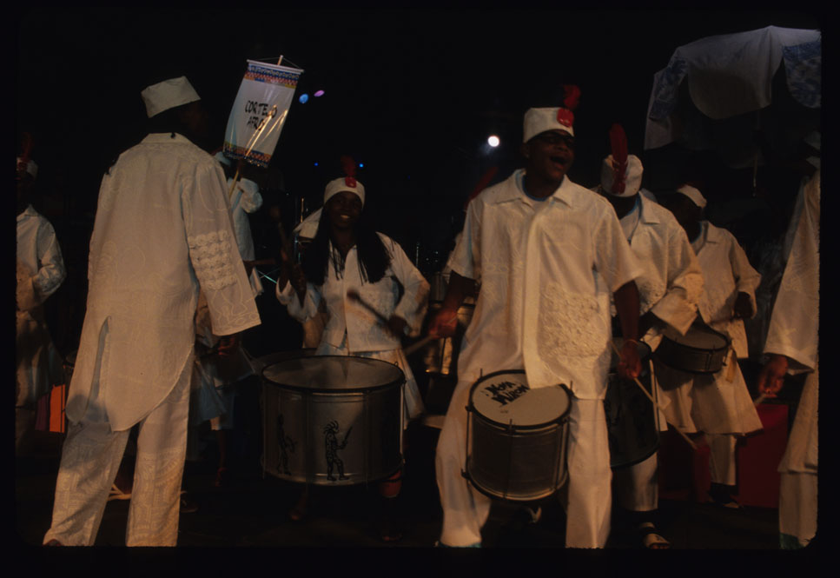
LOCAL MUSIC

Slide 17
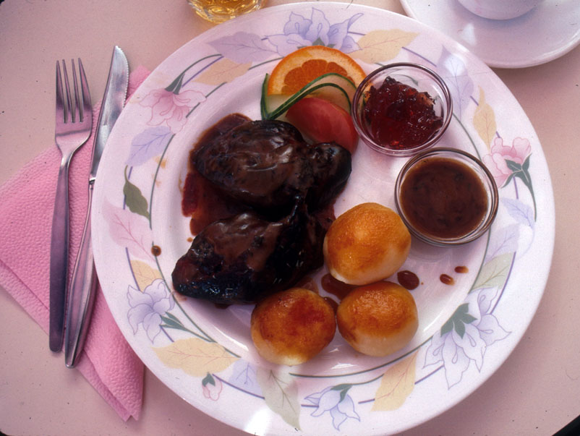
CUISINE

Slide 18

LOCAL CRAFTS

Slide 19
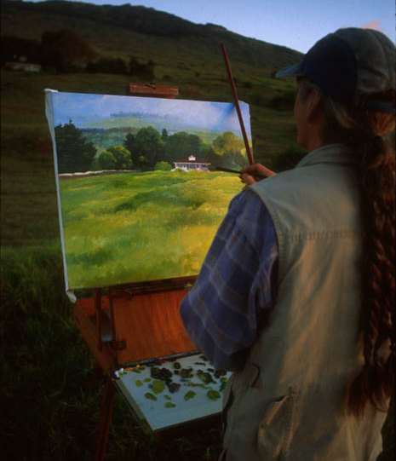
ARTS
Notes:
All of these elements are well brought out by the kind of creative entrepreneurs that can add texture to the travel experience and add up to “sense of place” -- this is what most people travel for.
“It’s not trickle down; it’s bottom up.” —Pres. Ricardo Maduro, Honduras

Slide 20
WTO definition of Sustainable Tourism
‘Sustainable tourism development meets the needs of present tourists and host regions while protecting and enhancing opportunity for the future.
It is envisaged as leading to management of all resources in such a way that economic, social, and aesthetic needs can be fulfilled while maintaining cultural integrity, essential ecological processes, biological diversity, and life support systems’
(World Tourism Organisation, 1997)

Slide 21
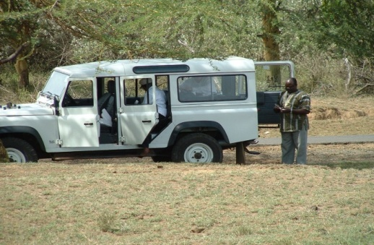
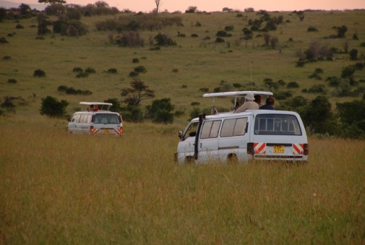
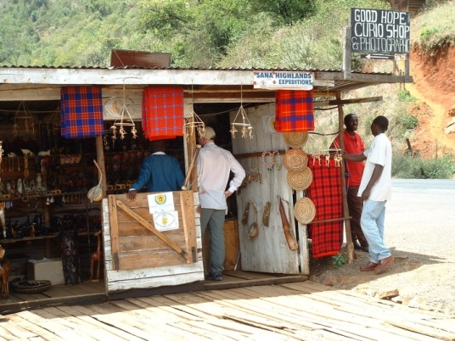
Three Core Elements
The holistic approach – environment, economy and society/culture
The time dimension – long term
Include all stakeholders

Slide 22
Society & culture
Environment
Economy

Slide 23
Balanced Priorities
Economic health
Well-being of society
Guest satisfaction
Protection
of natural resources
Healthy culture

Slide 24
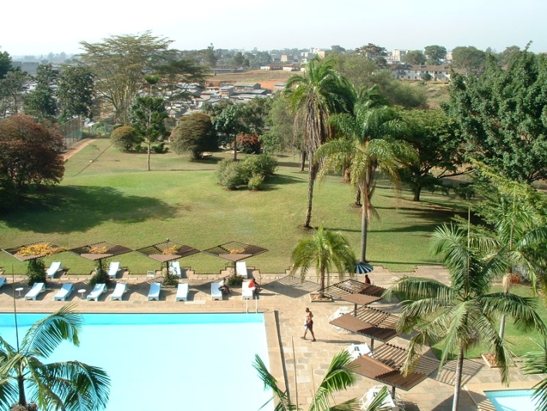
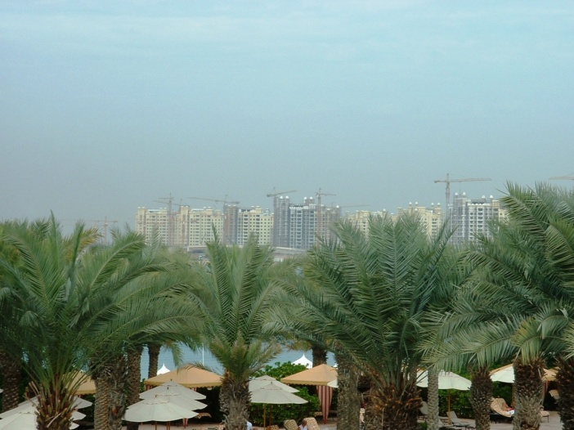
Issues of ethical concern
Relationship with host community
Treatment of employees
Marketing of products
Attitude to the natural environment

Slide 25
Sustainability Tools
Sustainable tourism development plans
Agenda 21 (regional, local)
Legislation and regulations: land use, infrastructure development, heritage assets
Management plans for protected natural areas and archaeological sites
Carrying capacity of tourism sites
Sustainability certification
Indicators

Slide 26
Example: Indicators
  Socio-cultural (covering issues related to community wellbeing, cultural assets, community participation, tourist wellbeing)
  Economic (covering capture of benefits, sustaining the tourist product)
  Environmental (covering protection of valuable natural assets, managing scarce resources, limiting the impacts of tourism activity)
  Tourism planning and management (destination planning and control, designing products and services, controlling tourist activity and managing quality)
  Responding to Global issues (e.g climate change, epidemics, sex tourism)

Slide 27


World Tourism Organization
UN Specialized Agency
Headquarters in Madrid, Spain
Intergovernmental organization with 150 Member States and Territories
350 Affiliate Members: private sector (tourism trade associations, major airlines, hotels, tour operators), local authorities, education and research institutions, NGOs
www.world-tourism.org/sustainable

Slide 28
World Tourism Organization
Regional Representation Sections:
Africa
Europe
Americas
Middle East
Asia-Pacific
Program Activity Sections:
Tourism Statistics
Market Intelligence and Promotion
Human Resources Development
Sustainable Development of Tourism
Quality of Tourism Development
Press and Communication, Documentation, Publications
Affiliate Members:
Business Council
Education Council
Destination Management Programme

Slide 29
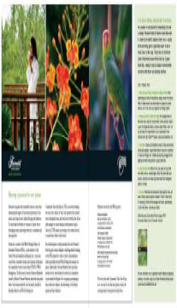
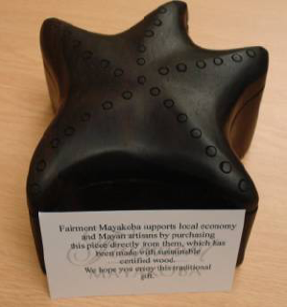
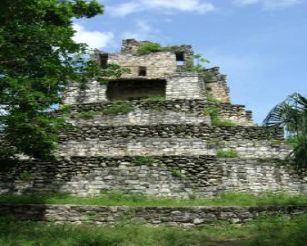
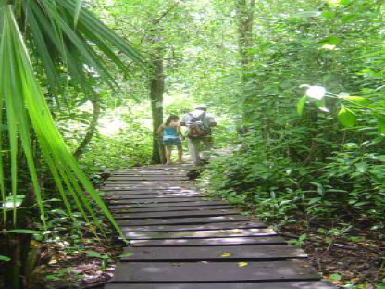
The Global Sustainable Tourism Criteria
WHAT IS GSTC?
A set of 37 criteria intended to frame the main components of sustainable tourism
The criteria are organized around the four pillars of sustainable tourism:
  effective sustainability planning
  maximizing social and economic benefits to the local community
  reduction of negative impacts to cultural heritage
  reduction of negative impacts to environmental heritage

Slide 30
Going Beyond Green
Sustainable Tourism (ST) is:
Holistic - because sustainability is about more than just the environment: it incorporates culture and heritage
Place-based – this works from the bottom up, requiring the participation of the people who know the place best - its residents
Marketable – ST can create financial incentives for good destination management, which in turn generates more interest - and spending - by tourists
Competitive – ST emphasizes, enhances and encourages development of the most unique aspects of a destination, making it a more desirable place

Slide 31

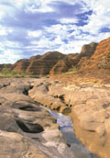
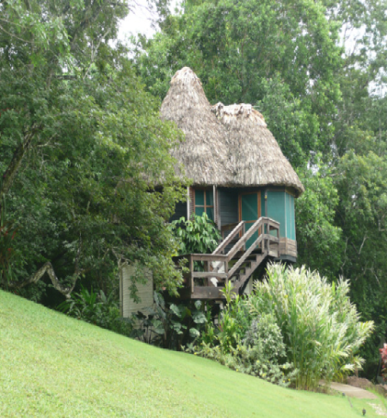
And most of all …
Sustainable tourism engages tourists, who have a more authentic experience…
and residents,
who gain a deeper appreciation for what makes their place unique

Slide 32

So how does sustainable tourism enhance and protect multicultural societies?

Slide 33
Contact me …
Resources, websites, ideas, notes will be available online:
www.gdrc.info/sms/
Send me an email anytime!
Hari Srinivas
hari.srinivas@kwansei.ac.jp
IMPORTANT:
When you send an email, please always put “[ZEMI]” in the subject line!

