Slide 1
Studies in Multicultural Societies
Different Peoples,
One World
Multiculturalism
and the United Nations
Hari Srinivas
Room: I-312 / 079-565-7406

Slide 2
General UN Membership
193 member states
“Peace loving nations”
NYC: “Sessions” Sept-Dec
Pay dues (% world wealth)
2010-11 Budget ($5.16 b)
Peacekeeping costs different ($8 b)
Provide troops for UN activities

Slide 3
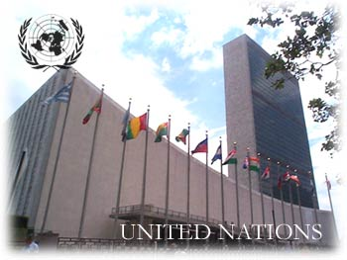
Goals of the U.N.
Maintain international peace & security
Put down threats to peace & aggressive acts
Promote respect for international law
Protect human rights and freedoms
Encourage social and economic progress (raise SOL)

Slide 4
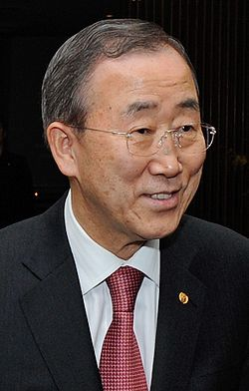
Activity: Structure of the UN
Identify the purpose, membership structure, and powers of the following branches:
General Assembly
Security Council
Secretariat
Economic and Social Council
Court of Justice
http://www.un.org/en/
Ban Ki-moon: S. Korea

Slide 5
General Assembly
Purpose: Open, deliberative forum
Membership:
All member nations (193)
1 vote per delegation
2/3rd vote to pass resolutions/mandates
Function/Powers:
Elect members of other organs
Debate issues and make (non-binding) recommendations
Approve budget and spending
Suspend or revoke membership

Slide 6
Security Council
Purpose: Maintain peace and security
Membership:
5 permanent members (China, France, Britain, US, Russia),
10 non-perm members (elected 2 yr terms by GA)
9/15 votes to take action, including all 5 perm
Function/Powers:
Investigate and mediate disputes (binding decisions)
Apply political and economic sanctions
Take military action when necessary

Slide 7
Secretariat
Purpose: Carry out daily operations
Membership:
Secretary General (Ban Ki-moon) – 5 yr
~50K+ workers in various agencies and offices (NYC main)
Function/Powers:
Administer programs and policies
Create press releases

Slide 8
Econ and Social Council
Purpose: Promote higher standard of living, econ and social progress
Membership:
54 members- regional representation
3 year terms
1 vote per nation
Function/Powers:
Formulate policy
Discuss & Initiate studies concerning econ/soc issues
Call international summits (mtgs)

Slide 9
Internatl Court of Justice
Purpose: Settle disputes of internatl law
Membership:
15 Justices (independent once elected)
9 year terms
Peace Palace (The Hague, Amsterdam)
Function/Powers:
Nations submitting disputes agree to decisions
Advise organs on legal questions

Slide 10
Trusteeship Council
Purpose: Oversee “trust territories” (11 nations w/out govt following WW2)
Membership: 5 Perm Security Nations
Function: None, all territories estblished self-govt eventually

Slide 11
Issues handled by the United Nations
The UN – through its different organizations, work on a range of issues such as -
Business
Children
Culture
Development
Emergencies
Environment
Health
HIV/AIDS
Human Rights
Labour
Peace
Women

Slide 12
Cultural issues, and the society at large, is a critical theme for all UN bodies
Culture
United Nations
Educational, Scientific and Cultural
Organization
(UNESCO)

Slide 13
Three meanings of Multiculturalism
The UN looks at multiculturalism from three perspectives – as a feature of the demographics of its members, as a part of its programmes and projects, and as an ‘ideology’
1. Demographic
2. Programmatic
3. Ideological

Slide 14
Three meanings of Multiculturalism
The UN looks at multiculturalism from three perspectives
The UN recognizes multiculturalism as an essential feature of the characteristics of its member states, that makes this world a very diverse place
Demographic
Programmatic
Ideological

Slide 15
Three meanings of Multiculturalism
The UN looks at multiculturalism from three perspectives
In programmatic terms, it 'multiculturalism' refers to specific types of programs and policy initiatives designed to respond to and manage ethnic diversity.
Demographic
Programmatic
Ideological

Slide 16
Three meanings of Multiculturalism
The UN looks at multiculturalism from three perspectives
Multiculturalism emphasises that ethnic diversity should go hand in hand with enjoying commonly shared values of a society.
Demographic
Programmatic
Ideological

Slide 17
Multiculturalism and UN Themes
Racism and discrimination
Migration and human rights
Multiculturalism
Heritage preservation

Slide 18
1. Racism and Discrimination
Acceptance of and commitment to multiculturalism was at the heart of the global fight against discrimination
Durban Declaration and Programme of Action (2001) - World Conference against Racism, Racial Discrimination, Xenophobia and Related Intolerance
21 March is celebrated globally as the “International Day for the Elimination of Racial Discrimination”

Slide 19
2. Migration and Human Rights
The UN promotes the respect for human rights of migrants, and to contribute to peaceful integration of migrants in society (UNESCO).
Developing multicultural societies as a goal to help migrants better contribute to society
International Convention on the Protection of the Rights of All Migrant Workers and Members of Their Families (2003)
Office of the High Commissioner for Human Rights (OHCHR)

Slide 20
3. Heritage Preservation
Respect for different cultures, and multiculturalism itself, lies at the core of heritage preservation policies
UN Agreements on heritage preservation:
Protection and Promotion of the Diversity of Cultural Expressions (2005)
Safeguarding of the Intangible Cultural Heritage (2003)
Protection of the Underwater Cultural Heritage (2001)
Protection of the World Cultural and Natural Heritage (1972)
Listings of World Heritage Sites is an example of heritage preservation

Slide 21
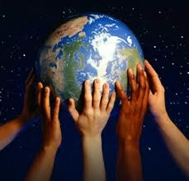
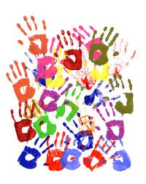
Other examples
UN HABITAT's "The State of the World's Cities Report 200/2005 " lauds multiculturalism as an urban phenomenon that should be celebrated
The UN Global Compact and doing business in a multicultural world
Promotion of peace as a part of multiculturalism

Slide 22
Working at the United Nations
The greatest strength of any organization is the quality of its staff members. This requires the creation of an organizational culture and environment that enables the staff to contribute to the best of their abilities.
When working at the United Nations, you need to have three “core values”
1. Integrity
2. Professionalism
3. Respect for Diversity

Slide 23
UN Core Value: Integrity
Upholds the principles of the organization
Demonstrates the values of the United Nations, including impartiality, fairness, honesty and truthfulness, in daily activities and behaviours.
Acts without consideration of personal gain.
Resists undue political pressure in decision-making.
Does not abuse power or authority.
Stands by decisions that are in the organization's interest even if they are unpopular.
Takes prompt action in cases of unprofessional or unethical behaviour.

Slide 24
UN Core Value: Professionalism
Shows pride in work and in achievements.
Demonstrates professional competence and mastery of subject matter.
Is conscientious and efficient in meeting commitments, observing deadlines and achieving results.
Is motivated by professional rather than personal concerns.
Shows persistence when faced with difficult problems or challenges.
Remains calm in stressful situations.

Slide 25
UN Core Value: Respect for Diversity
Works effectively with people from all backgrounds.
Treats all people with dignity and respect.
Treats men and women equally.
Shows respect for, and understanding of, diverse points of view and demonstrates this understanding in daily work and decision-making.
Examines own biases and behaviours to avoid stereotypical responses.
Does not discriminate against any individual or group.

Slide 26
Contact me …
Resources, websites, ideas, notes will be available online:
www.gdrc.info/sms/
Send me an email anytime!
Hari Srinivas
hari.srinivas@kwansei.ac.jp
IMPORTANT:
When you send an email, please always put “[ZEMI]” in the subject line!

