Slide 1
Studies in Multicultural Societies
Different Peoples,
One World
Politics of Multicultural Societies: The Case of EU
Hari Srinivas
Room: I-312 / 079-565-7406

Slide 2
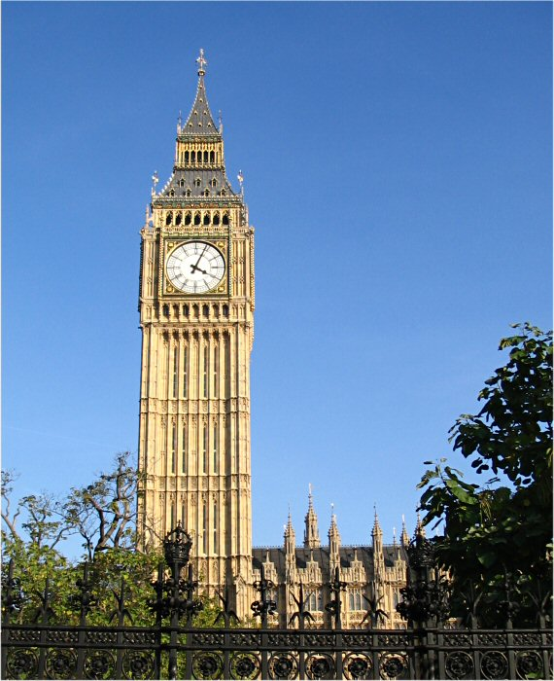

Slide 3
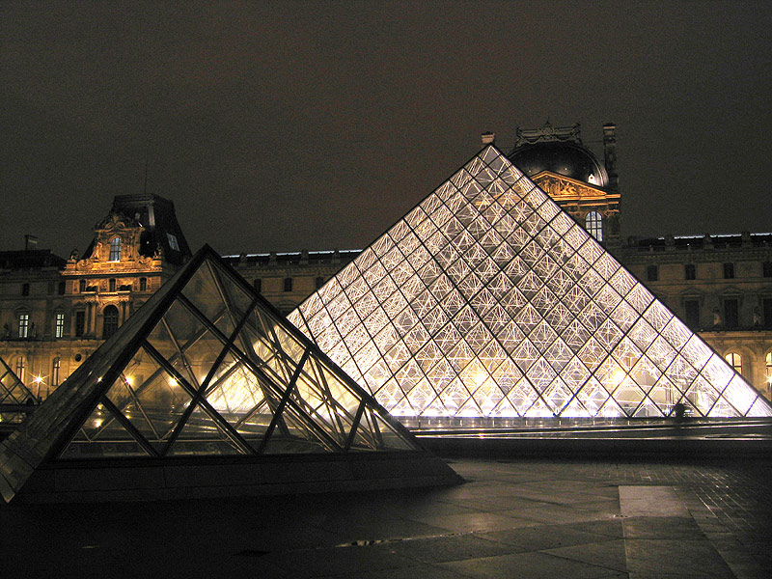

Slide 4
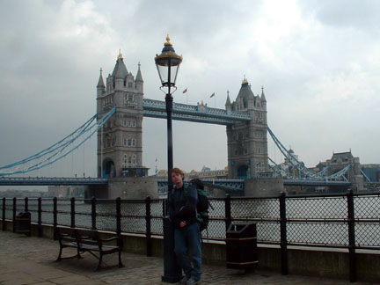

Slide 5
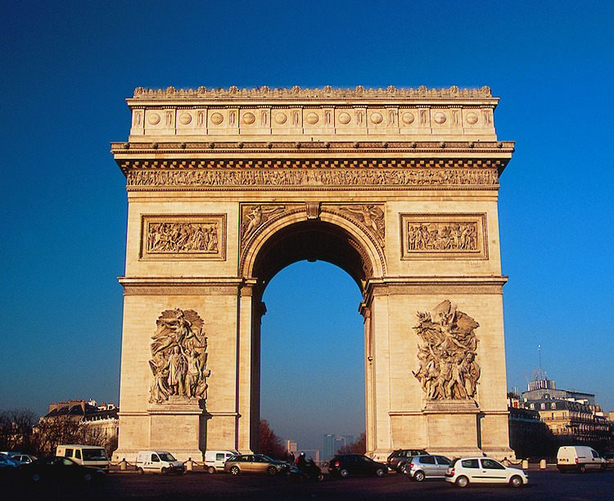

Slide 6
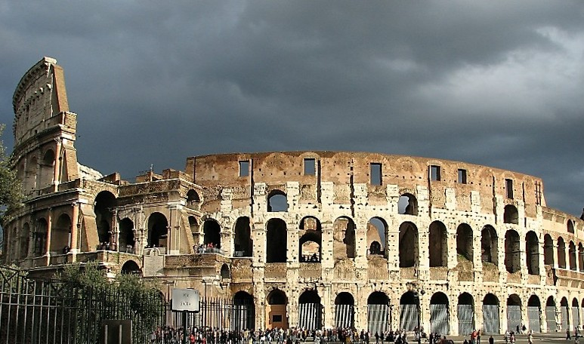

Slide 7
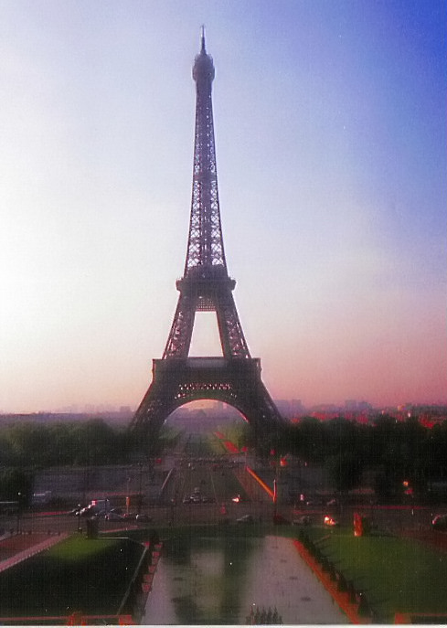

Slide 8
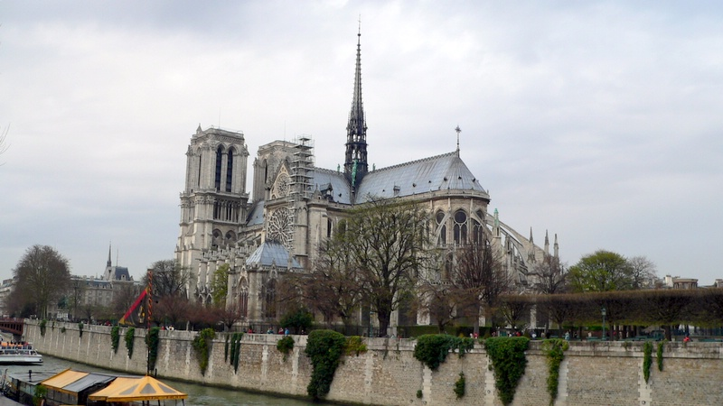

Slide 9
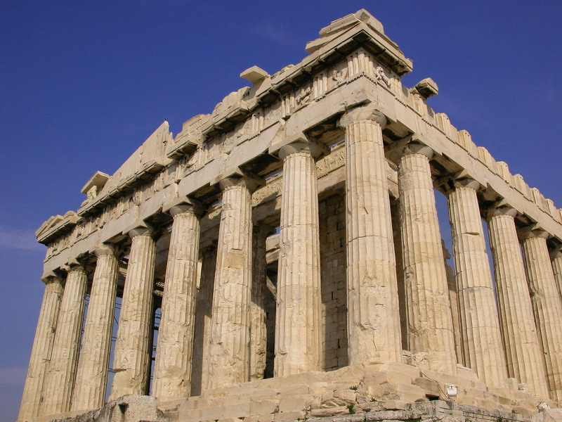

Slide 10
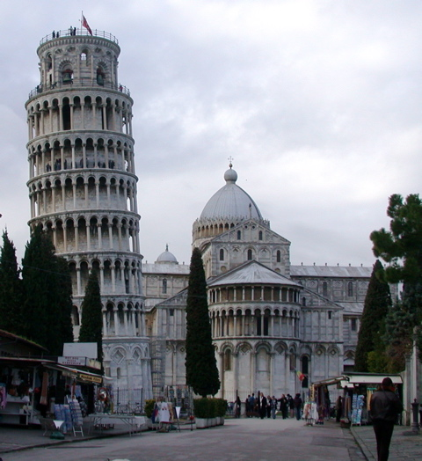

Slide 11
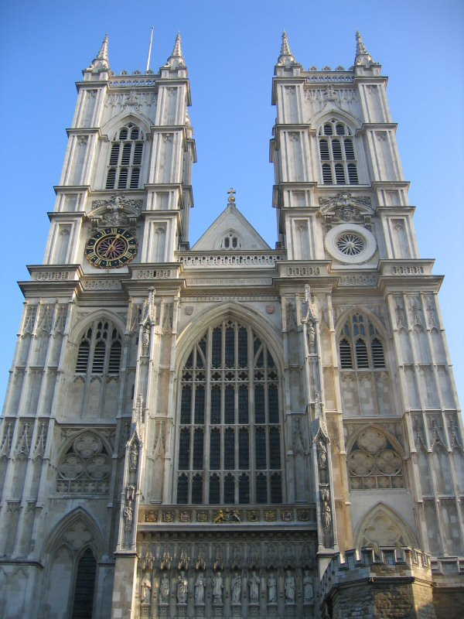

Slide 12
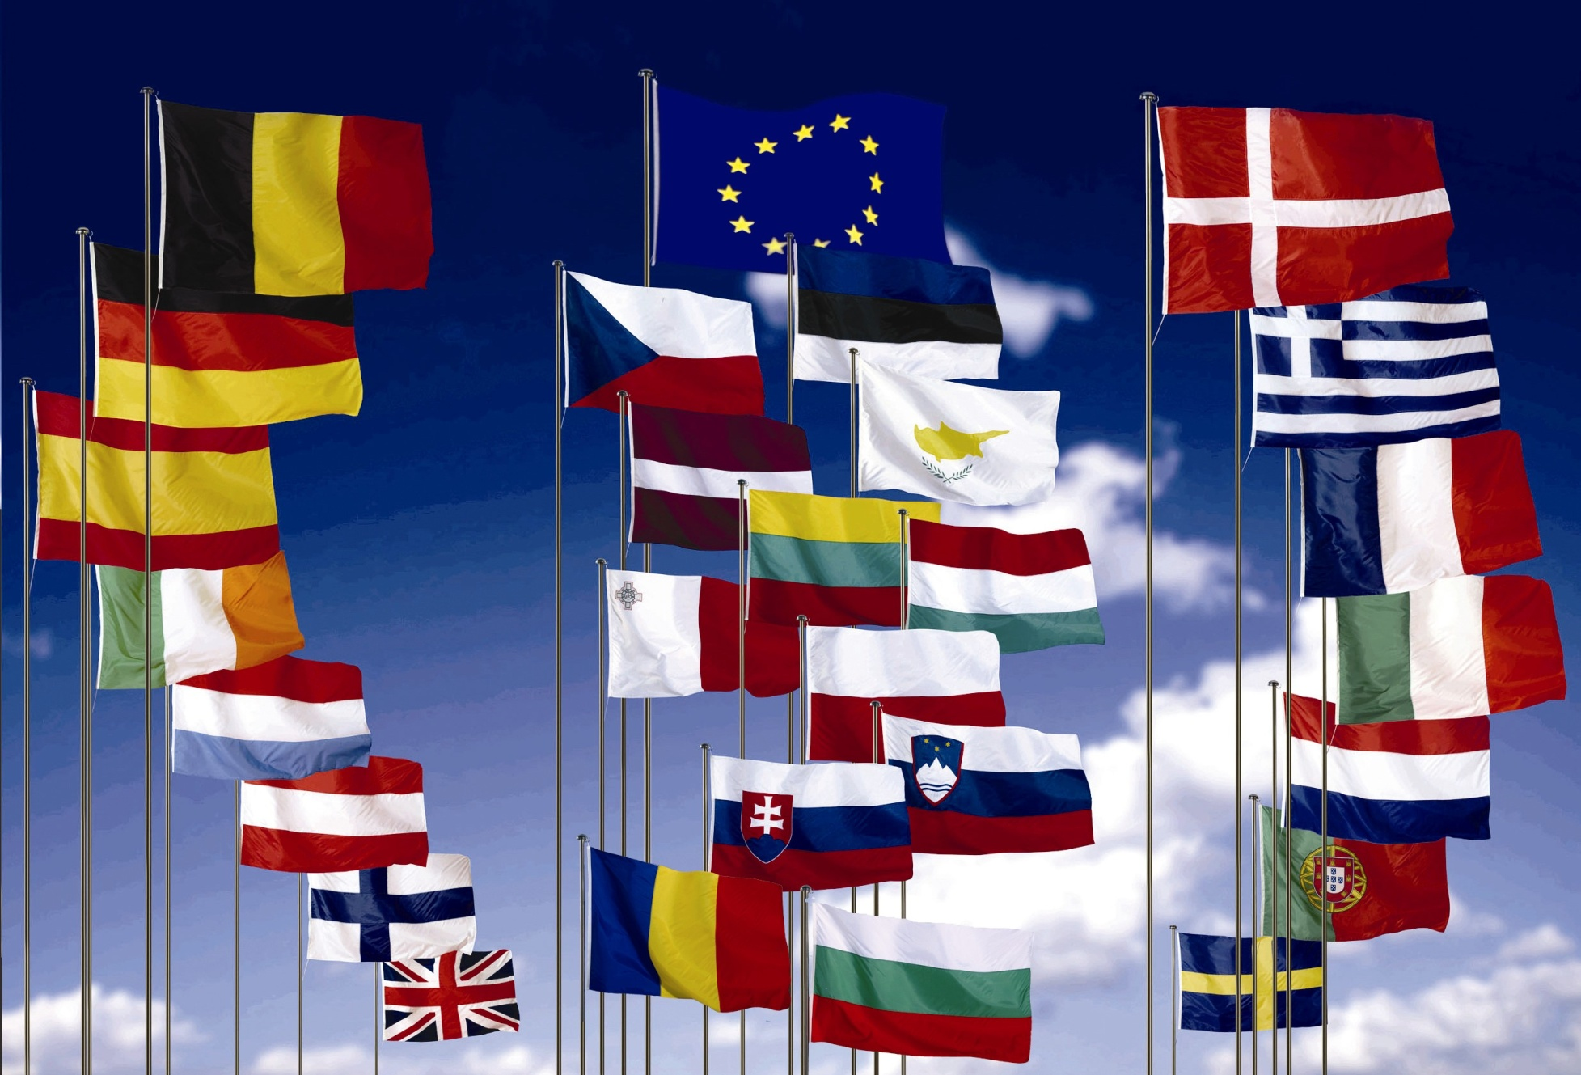
28 Countries of the European Union
Of the 47 countries that are located in Europe, 28 form the European Union

Slide 14
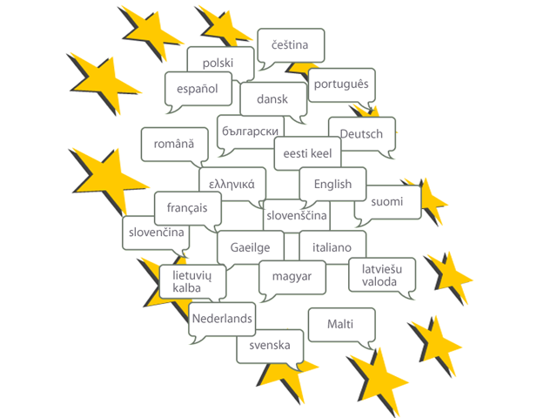
23 Official Languages

Slide 15
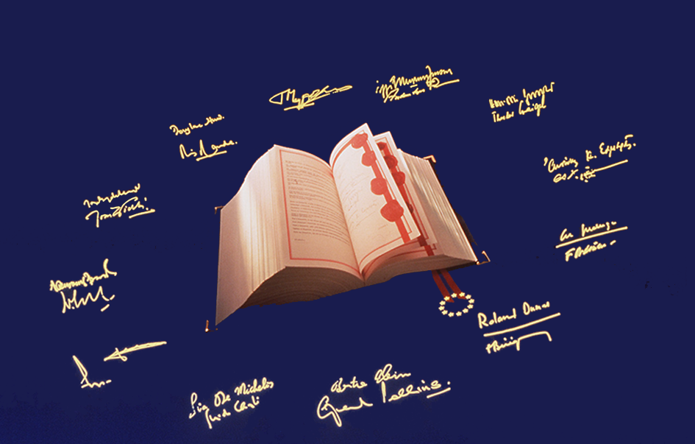
The Treaties – Basis for democratic cooperation built on law
1952 The European Coal and Steel Community (ECSC)
1958 The treaties of Rome:
The European Economic Community
(EEC)
The European Atomic Energy Community
(EURATOM)
2009
Treaty of Lisbon
1987 The Single European Act
2003 Treaty of Nice
1993 Treaty on European Union – Maastricht
1999 Treaty of Amsterdam

Slide 16
Founders – International Cooperation
New ideas for lasting peace and prosperity…
Konrad Adenauer
Alcide De Gasperi
Winston Churchill
Robert Schuman
Jean Monnet

Slide 17
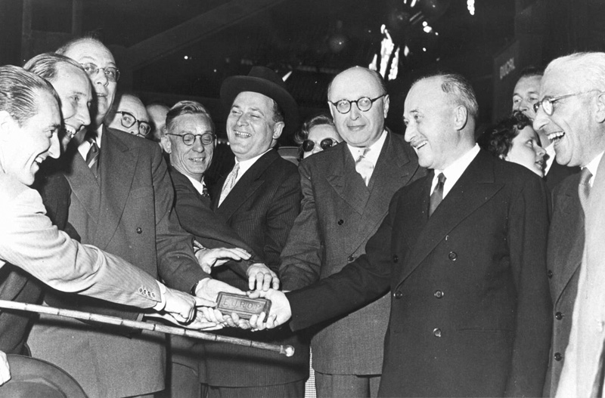
1952:
European Coal and Steel Community
In the aftermath of World War II, the aim was to secure peace among Europe’s victorious and vanquished nations and bring them together as equals, cooperating within shared institutions.
Based on a plan by French Foreign Minister Robert Schuman.
Six founding countries – Belgium, the Federal Republic of Germany, France, Italy, Luxembourg and the Netherlands – signed a treaty to run heavy industries (coal and steel) under common management.
Jean Monnet and other leaders with
the first “European” ingot of steel

Slide 18
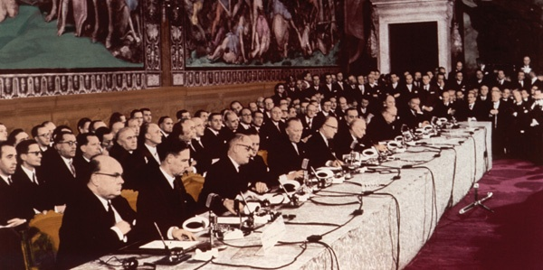
Treaty of Rome
1958:
The six founding countries expanded cooperation to other economic sectors, creating the European Economic Community (EEC) – or “common market.”
As a result, people, goods, services, and capital today move freely across the Union.
Signing of the Treaty of Rome, 1957

Slide 19
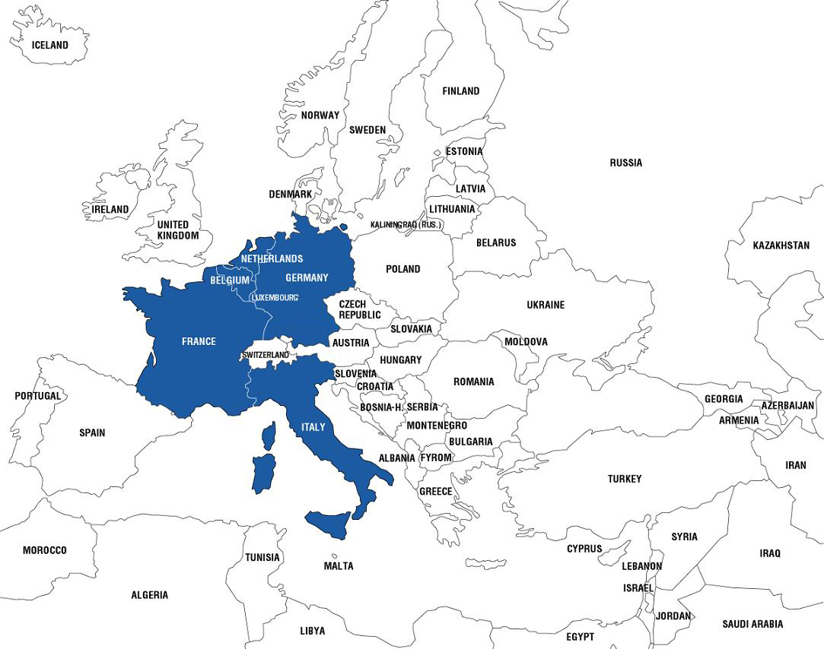
1952
Founding Members
Belgium
France
Germany
Italy
Luxembourg
Netherlands

Slide 20
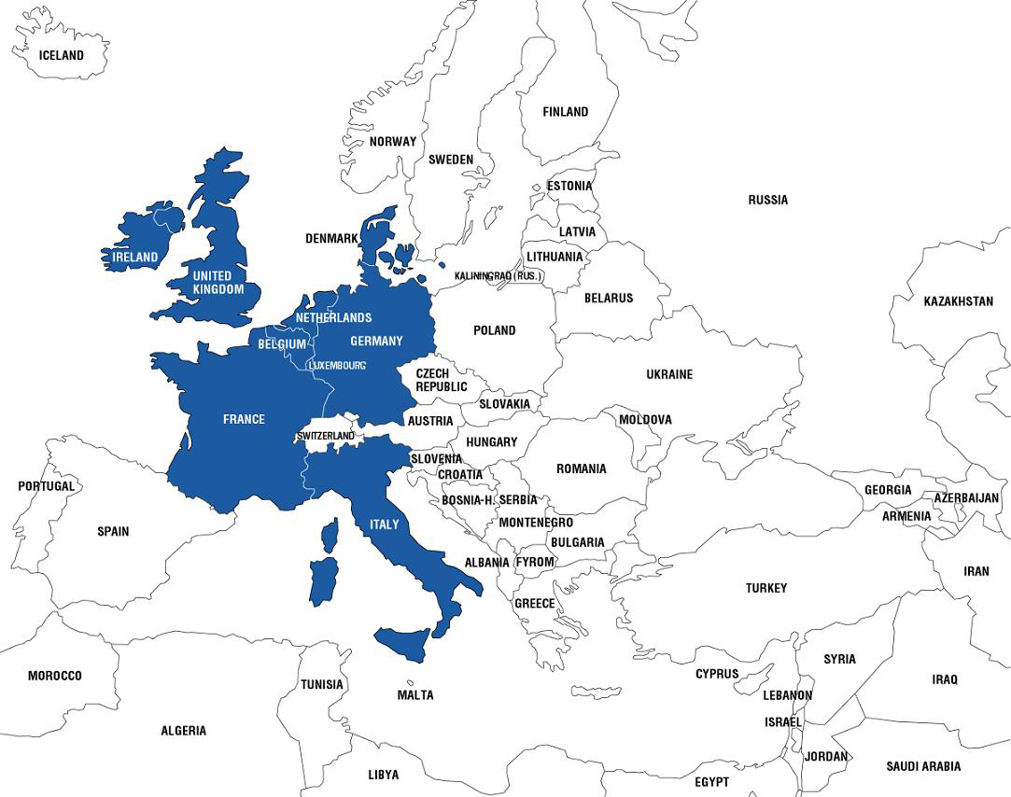
1973
Denmark
Ireland
United Kingdom

Slide 21
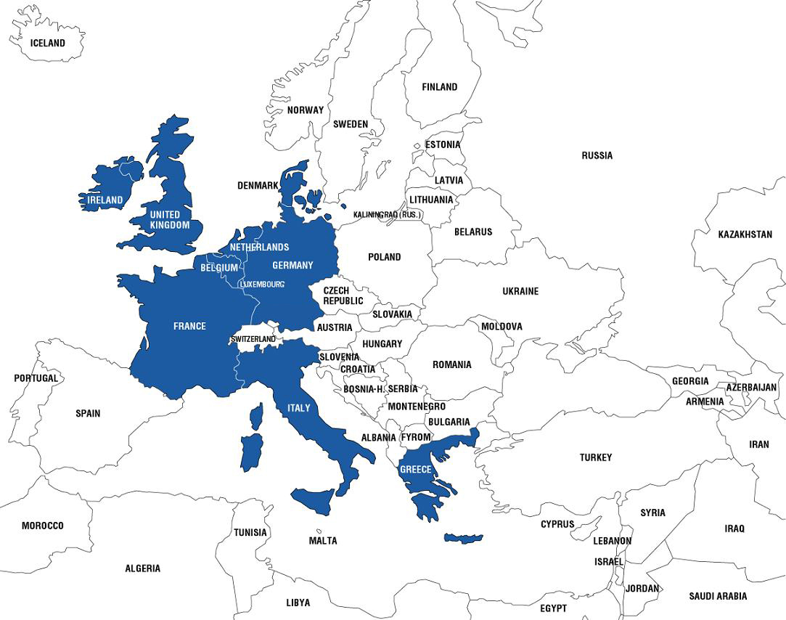
1981
Greece

Slide 22
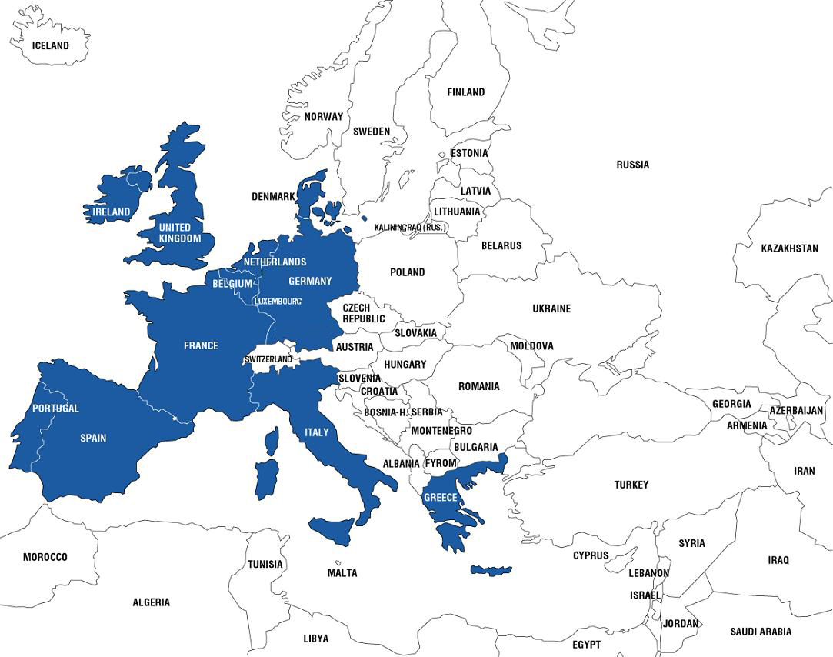
1986
Portugal
Spain

Slide 23
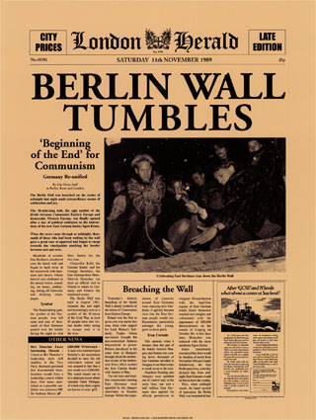
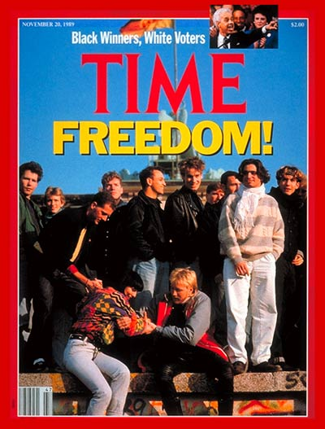
1989
Fall of the
Berlin Wall
sets the
stage for
unifying
Europe and
EU enlargement
+
Poland’s Solidarity Party gains legal status

Slide 24
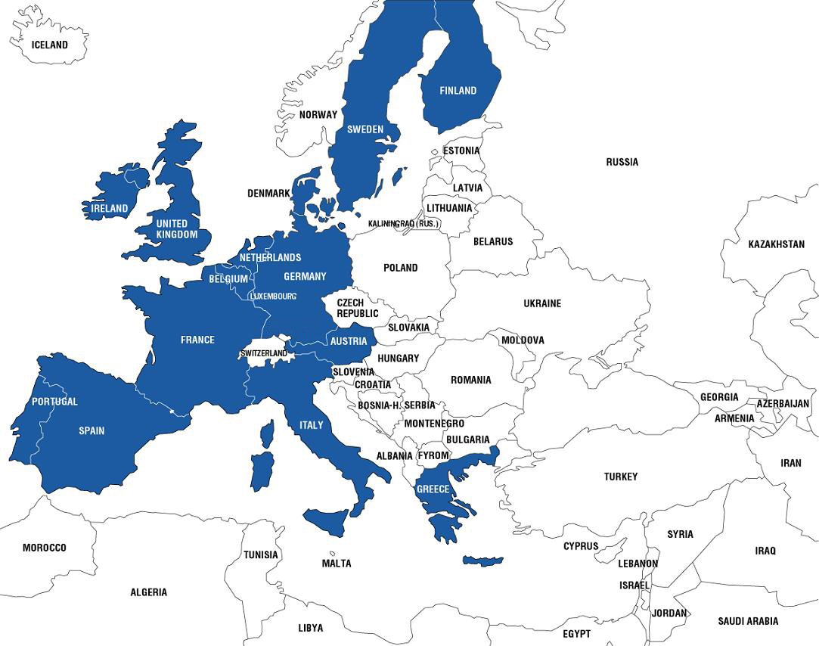
1995
Austria
Finland
Sweden

Slide 25
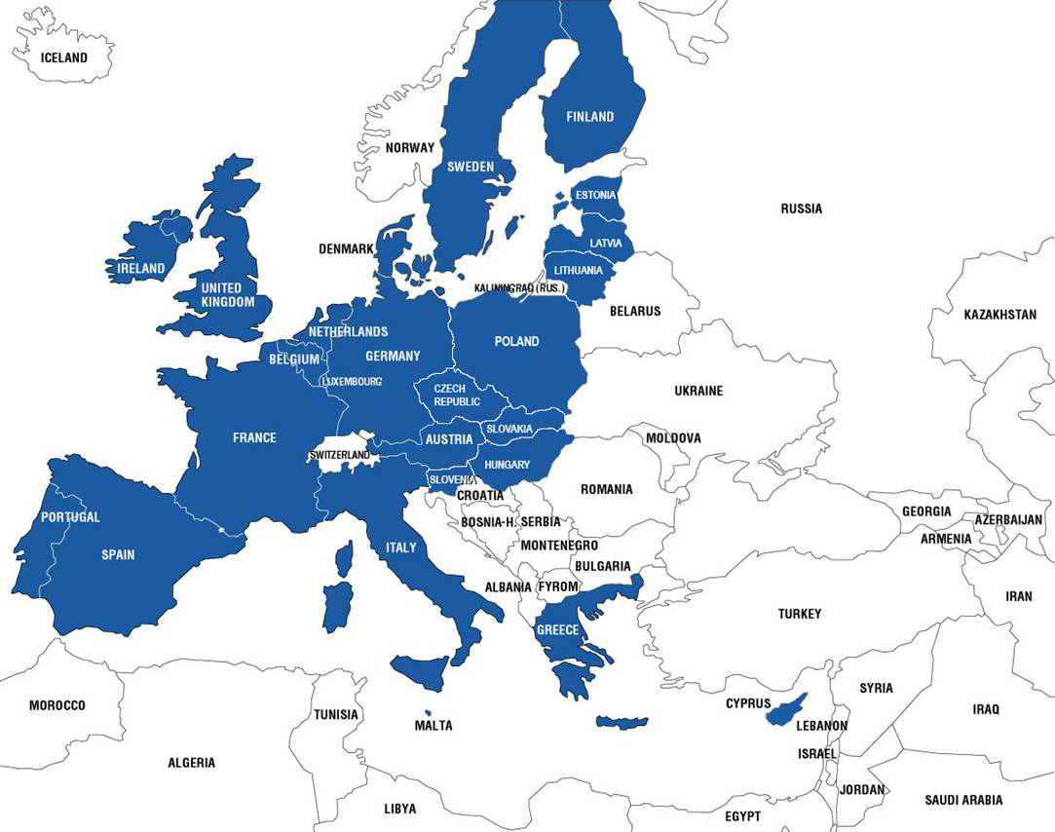
2004
Cyprus
Czech Republic
Estonia
Hungary
Latvia
Lithuania
Malta
Poland
Slovakia
Slovenia

Slide 26
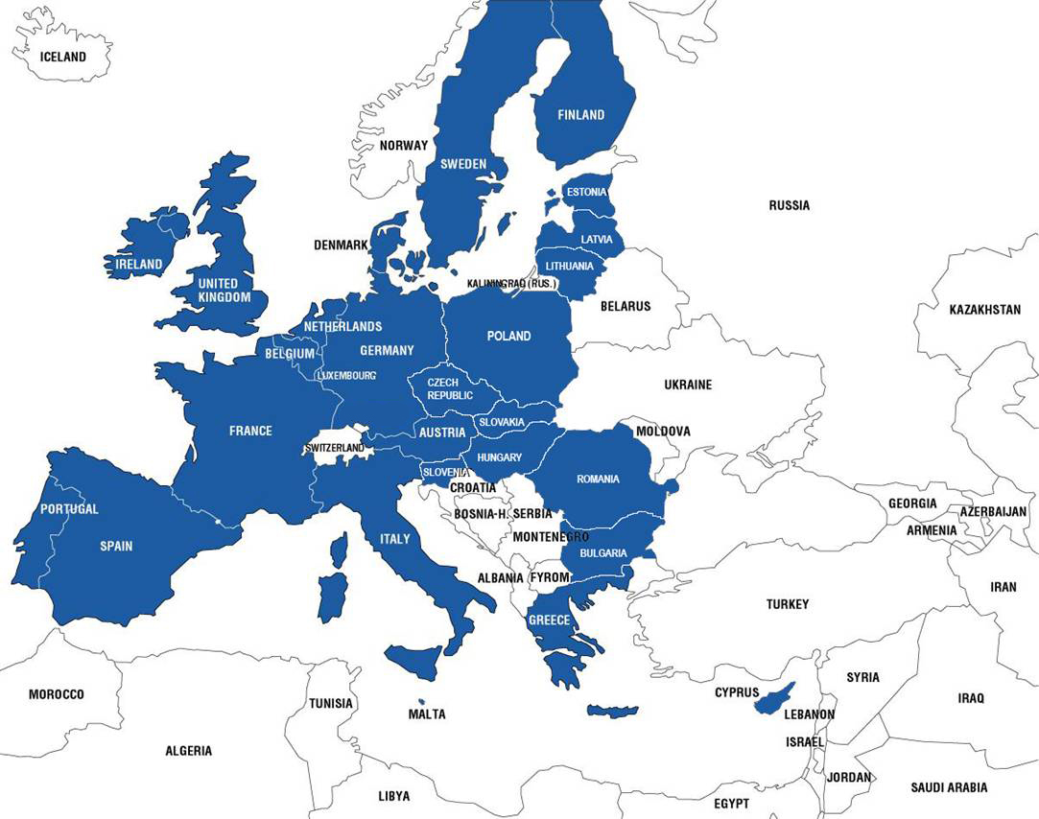
2007
Bulgaria
Romania

Slide 27
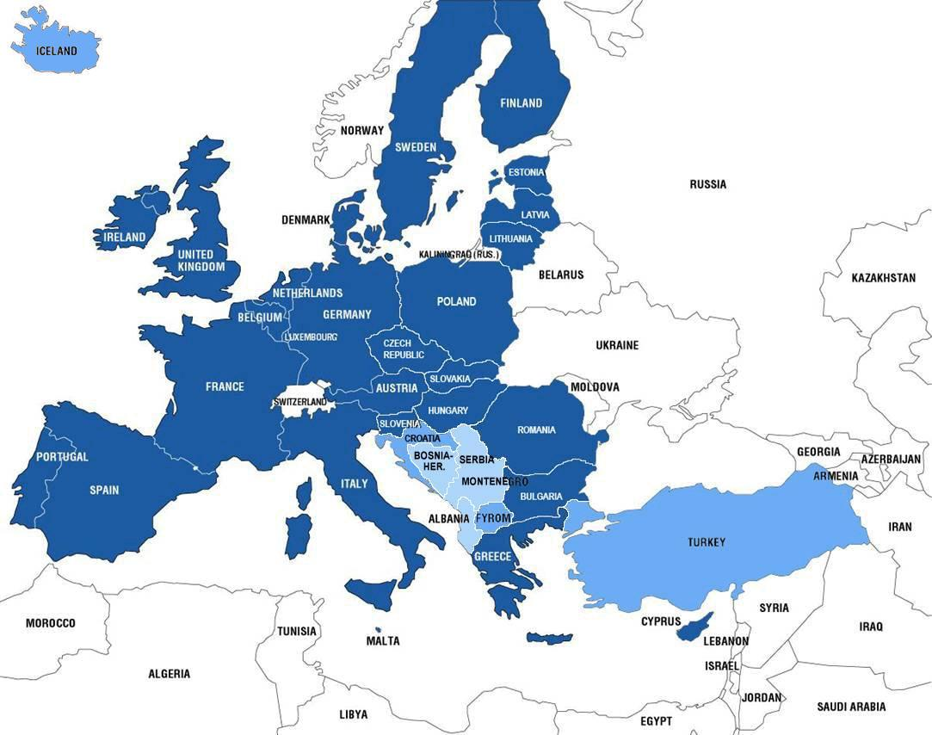
Candidate Countries
Croatia
former Yugoslav Republic of Macedonia
Iceland
Turkey
Potential
Candidate Countries
Albania
Bosnia & Herzegovina
Kosovo under UN
Security Council Resolution 1244
Montenegro
Serbia

Slide 28
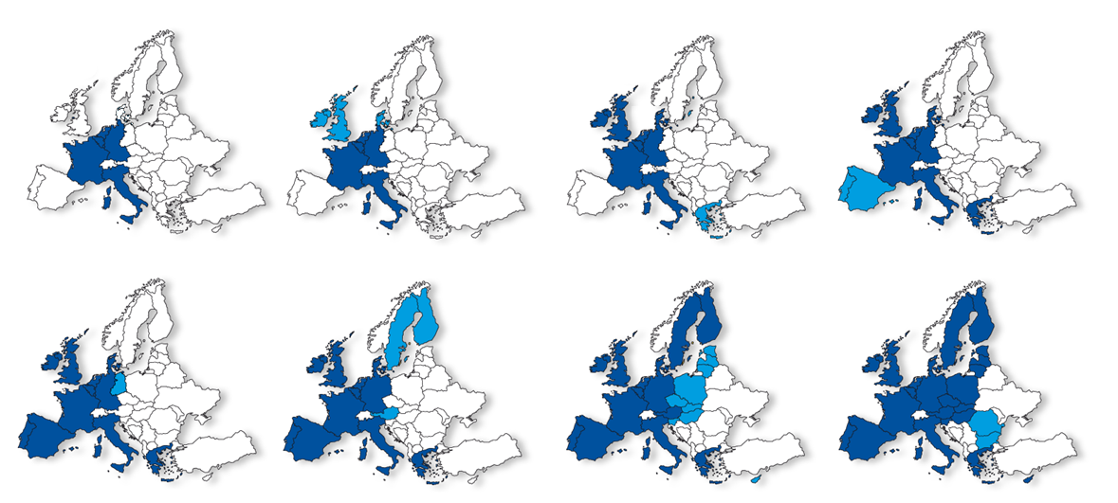
Enlargement – from 6 to 27 countries
1952
1973
1981
1986
1990
1995
2004
2007

Slide 29
Over 50 Years of EU Integration
Enlargement has:
Inspired reforms and consolidated common principles of liberty, democracy, respect for human rights, fundamental freedoms and the rule of law, while enabling market-oriented economic reforms.
Enhanced the EU’s weight in the world and made it a stronger and more attractive international partner.
“Enlargement has been a success story for the European Union and Europe as a whole. It has helped to overcome the division of Europe and contributed to peace and stability throughout the continent.”
European Council Declaration Dec. 15, 2006
1957 2009
Member States 6 27
Population 174 million 500 million
Languages 4 23

Slide 30
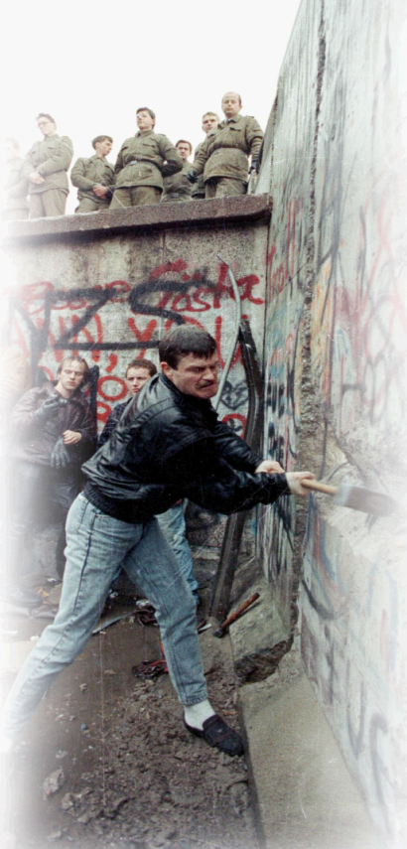
The Big Enlargement – healing the division of Europe
1989
Fall of Berlin Wall – end of Communism in Central and Eastern Europe
EU economic help begins: PHARE program
1993
Criteria set for a country to join the EU:
• democracy and rule of law
• functioning market economy
• ability to implement EU laws
1998
Formal negotiations on enlargement begin
2002
Copenhagen summit agrees enlargement
2004
10 new EU members: Cyprus, Czech Republic, Estonia, Hungary, Latvia, Lithuania, Malta, Poland, Slovakia, Slovenia
2007
Bulgaria and Romania join the EU
© Reuders
Candidates:
Croatia, former Yugoslav Republic of Macedonia, Iceland, Turkey

Slide 31
The Lisbon treaty –
taking Europe into the 21st century
The Treaty will make the European Union:
More efficient Simpler processes, full-time president for the Council.
More democratic Stronger role for the European Parliament and national parliaments, "Citizens Initiative", Charter of Fundamental Rights.
More transparent Clarifies who does what, greater public access to documents and meetings.
More united on High Representative for Foreign Policy.
the world stage
More secure New possibilities to fight climate change and terrorism, secure energy supplies.

Slide 32
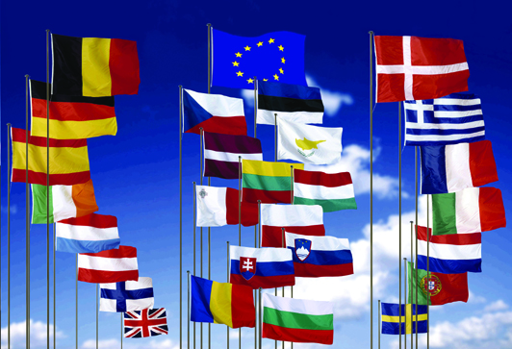
Celebrating the European Union - A Half Century of Change and Progress
Since the creation of the EU half a century ago, Europe has enjoyed the longest period of peace in its history.
European political integration is unprecedented in history.
EU enlargement has helped overcome the division of Europe – contributing to peace, prosperity, and stability across the continent.
A single market and a common currency benefit companies and consumers.
EU has united the citizens of Europe – while preserving Europe’s diversity.
European Union
United in diversity

Slide 33
The Single Market - freedom of choice
Has led to:
significant reductions in the price of
many products and services,
including internet access and
airfares.
40% drop in price of phone calls from
2000-2006
2.8 million new jobs
Four freedoms of movement: 4 goods 4 services 4 people 4 capital
© Getty Images

Slide 34
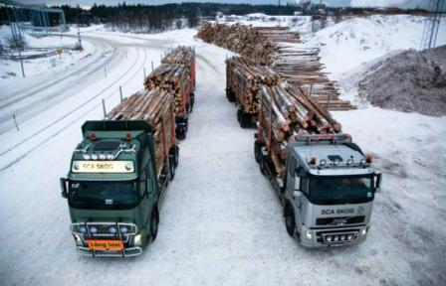
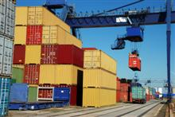
Free movement of goods
No customs duties between the member states
The EU also prohibits charges having an equivalent effect of customs duties.

Slide 35
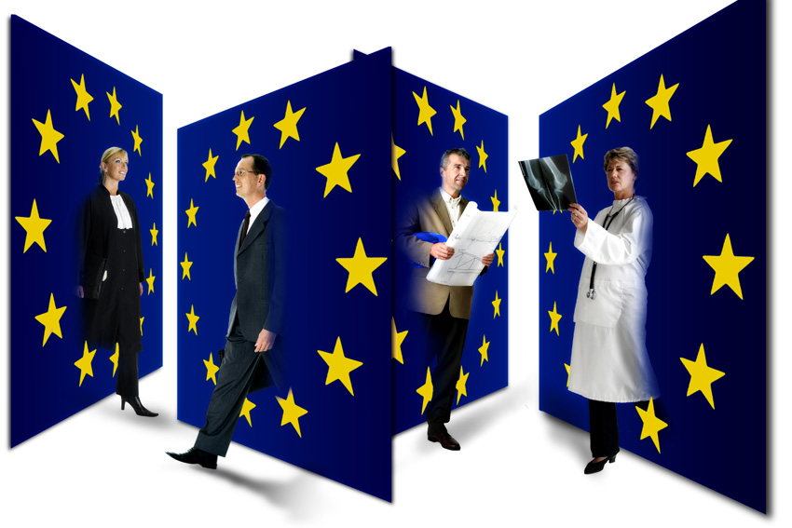
Free movement of services
The freedom prohibits restrictions on free circulation of services within Member States.
Examples:
Postal service
Internet purchases
Banking

Slide 36
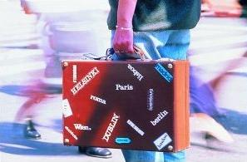
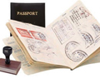
Free movement of people
The right to travel.
The right to work in any member state.
The right to settle in any member state.

Slide 37
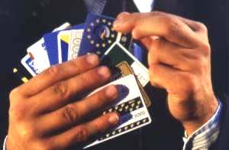
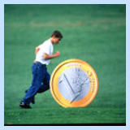
Free movement of capital
Capital within the EU may be transferred in any amount from one country to another.

Slide 38
The Future
Europe’s challenges vary
Balance of economically emerging eastern Europe and advanced/developed western Europe
Europe’s role in global governance, particularly the United Nations
International immigration to Europe
Common political ideals
Multiculturalism
International migration

Slide 39
Contact me …
Resources, websites, ideas, notes will be available online:
www.gdrc.info/sms/
Send me an email anytime!
Hari Srinivas
hari.srinivas@kwansei.ac.jp
IMPORTANT:
When you send an email, please always put “[SMS]” in the subject line!

