Slide 1
Studies in Multicultural Societies
Different Peoples,
One World
  Diversity and National Identity:
  The Case of India
Hari Srinivas
Room: I-312 / 079-565-7406

Slide 2
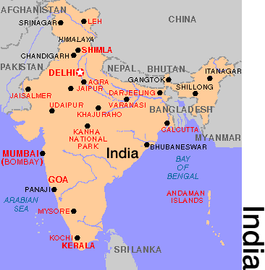
Geography of India
India is considered a “subcontinent” because of its size.
In the north are high mountains, the Himalayas and Hindu Kush. In the center is the Deccan Plateau.
Himalayan Mts.

Slide 3
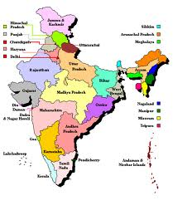
States in India
India is a federal union of states comprising twenty-eight states and seven union territories.
Most states differ from one another in language, culture, cuisine, clothing, literary style, architecture, music and festivities.

Slide 4
India: Historical Timeline
BCE: Before the Common Era
CE: Common Era
3000
BCE
2000
BCE
1000
BCE
0
CE
250
CE
500
CE
750
CE
1000
CE
1250
CE
1500
CE
1750
CE
2000
CE
- Indus Valley
Chalukya
Kushan
Gandiji
- Vedic Time
Md Gazini
Babur
Harappan
Civilization
Khajuraho
- Ancient India
Taj Mahal
Buddha
Born
Gupta
- Medieval India
- Post-Medieval
Mahavir
(Jainism)
Chola
(South)
Seashore
Temple (South)
- British
Classical
Sanskrit
East
India Co
- Modern
Alexander
the Great
Tanjore Temple
(South)
Brit
India War
Tamil
Grammar
Free
India

Slide 5
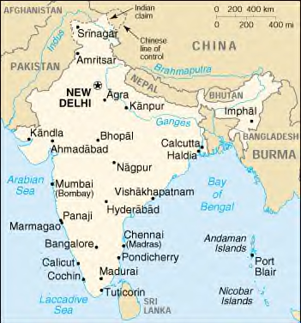
Indus Valley
The Indus River is located in Pakistan.
It was along this river that the Indus Valley Civilization developed around 2,500 BCE.
Two major cities of this civilization were Harappa and Mohenjo-Daro.

Slide 6
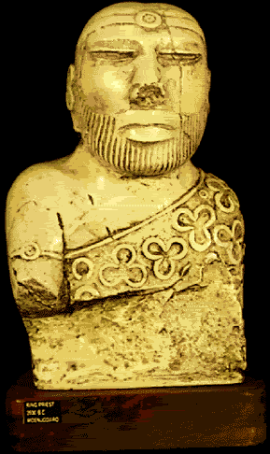
The Indus Valley Culture
The people of the Indus Valley were mostly peaceful farmers.
They built large cities with ordered streets and bricks made all the same size.
This indicates they had a strong central government.
This statue is probably a priest or king.

Slide 7
Aryan Invasion
Around 1500 BCE, a group of nomadic warrior-herders crossed the narrow Khyber Pass in the Hindu Kush Mountains and invaded the Indus Valley culture.
These people, the Aryans, came from Eastern Europe between the Black Sea and Caspian Sea, probably looking for pastures for their animals.
Flooding and earthquakes had weakened the Indus Valley culture and they were unable to withstand the newcomers.

Slide 8
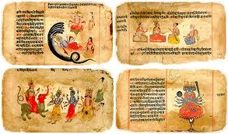
Two Cultures Combine
The Aryans developed Sanskrit and a number of religious and cultural beliefs.
The Indus Valley people eventually intermixed with the Aryans
Hinduism, the major religion of India, was a mixture of Aryan and Indus Valley beliefs.
A key contribution of this period is the four ancient texts of Vedas

Slide 9
Invasions of India
There were three key invasions of India over its history that shaped its cultures:
  The Aryan Invasion of 1500 BC – this gace raise to the Hindu religion, the Sanskrit language and a number of ancient texts called vedas
  The Muslim Invasions of 10-12 centuries, which brought Islam and Islamic cultures to north India
  The European Invasions of 17 century, that brought the colonial powers of Dutch, Protuguese, Spanish and finally the British empires

Slide 10
Religion in India
India is the birthplace of four of the world's major religious traditions, namely Hinduism, Buddhism, Jainism and Sikhism.
Throughout its history, religion has been an important part of the country's culture.
Religious diversity and religious tolerance are both established in the country by law and custom.
A vast majority of Indians associate themselves with a religion.

Slide 11
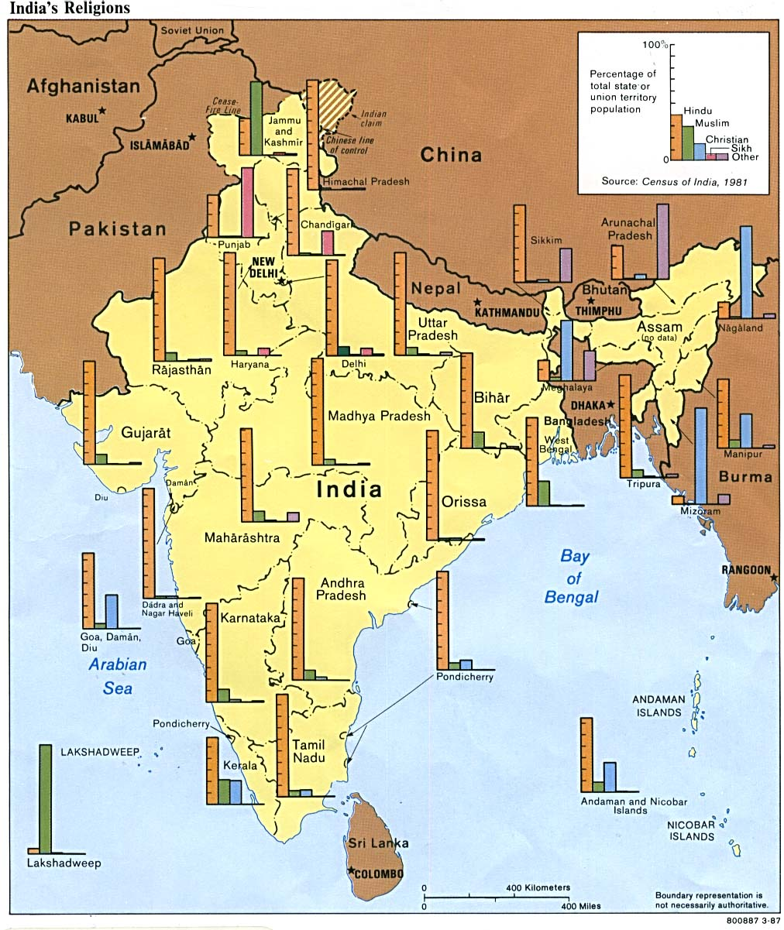
Religion in India
India is a Secular Country
No State Sponsored Religion
Major Religions
  Hindu: 75%
  Muslim: 12%
  Christian: 6%
  Sikh, Jain, Buddhist, & Jews: 7%
Ironically religion is a uniting feature
Most people are tolerant, very private about their religion
Religion is becoming less important

Slide 12
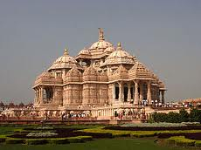
Hinduism
Hinduism differs from other religions like Christianity, Judaism and Islam:
There is no one single founder or one set of beliefs that must be followed.
There are thousands of gods and goddesses in Hinduism.
Most of the beliefs of Hinduism came from the oral traditions of the Vedas—or holy writings.
Hinduism is a conglomeration of distinct intellectual or philosophical points of view, rather than a rigid common set of beliefs.

Slide 13
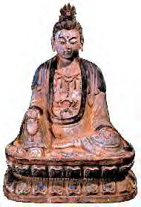
Buddhism
Around 566 BC, Siddharta Guatama was born into a royal family in North India
After seeing the pain and misery of life, he decided to find a way of living that would allow people to find peace in life.
His explorations led to the development of Buddhism. Gautama became known as Buddha, which means “enlightened one.”
He developed the Four Noble Truths and The Eightfold Path. These are rules to live by that help people live morally and find the “middle path”.

Slide 14
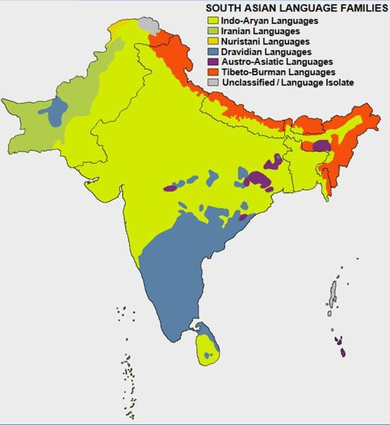
Language in India
415 living languages (a total of more than 2000 languages)
Two official languages of communication:
  Hindi and English
There are “official languages” at the state and center but no one “national language”
14 official regional languages

Slide 15
Sanskrit Literature
Mahabharata
One of the world’s longest literary works
The story of two Indian families struggling for control of a kingdom
Many long passages of Hindu beliefs and practices
Ramayana
The story of a god, Vishnu, who took a human form
Written long after the Mahabharata; contains models for the ideal ruler (Rama) and the ideal mate (Sita)

Slide 16
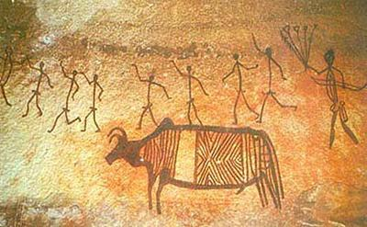
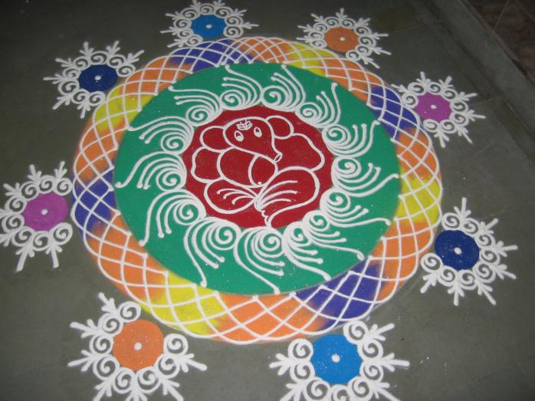
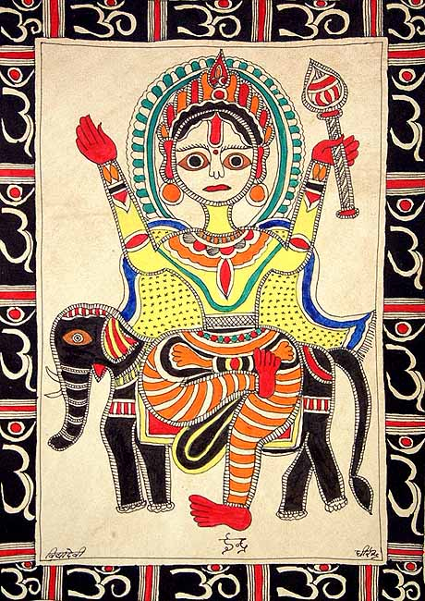
India: Art
Rock paintings
Rangoli (floor art)
Folk/Traditional art

Slide 17
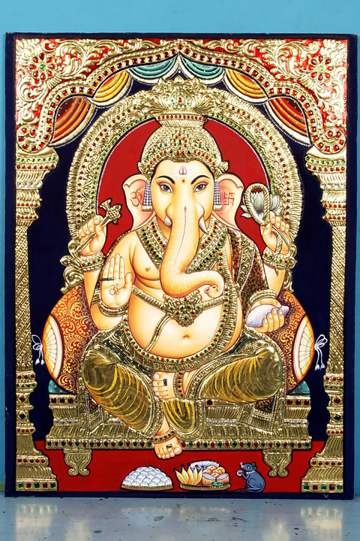
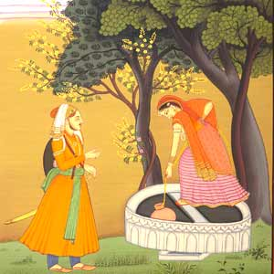
India: Art
Tanjore Style
Rajput Paintings

Slide 18
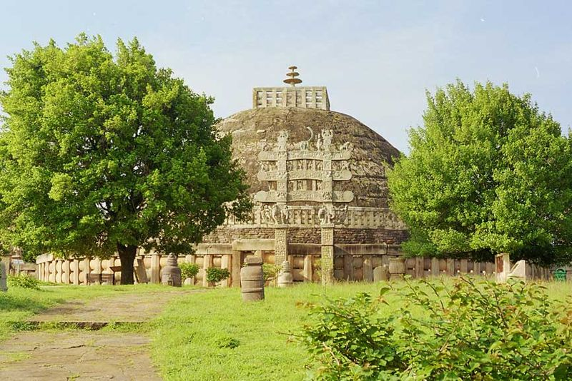
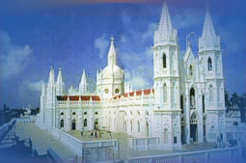
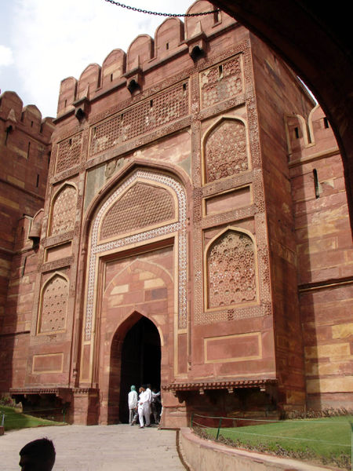
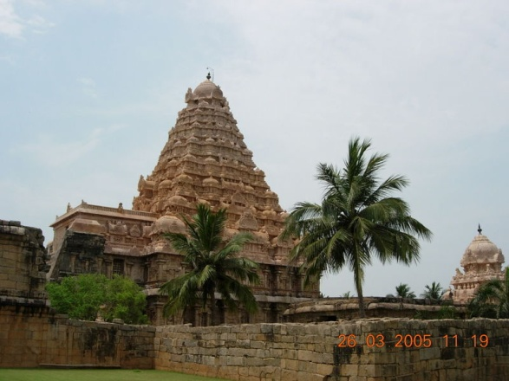
India: Architecture
Church Our Lady of Health, 18th Cent.
Sanchi, Buddhist, 3 BCE
Kangaikonda Cholapuram Hindu Temple, 11th Cent
Agra Fort, 16th Cent.

Slide 19
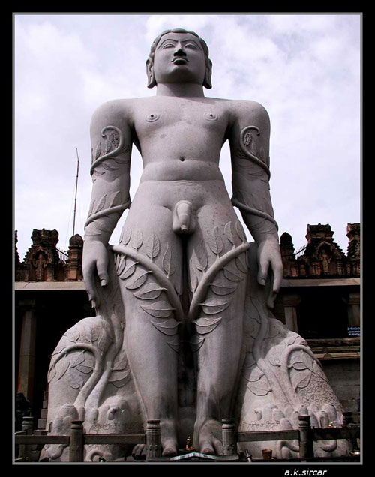
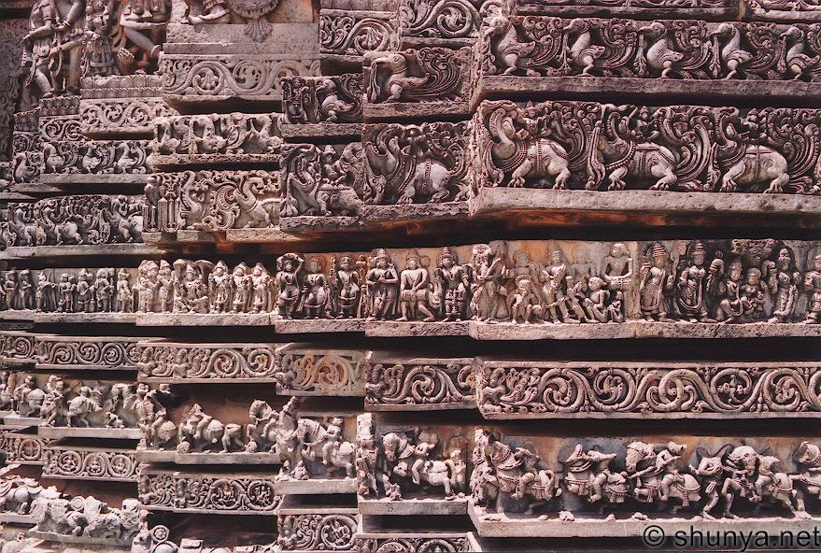
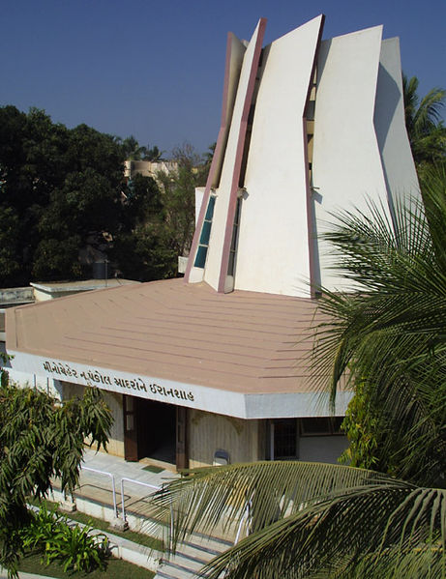
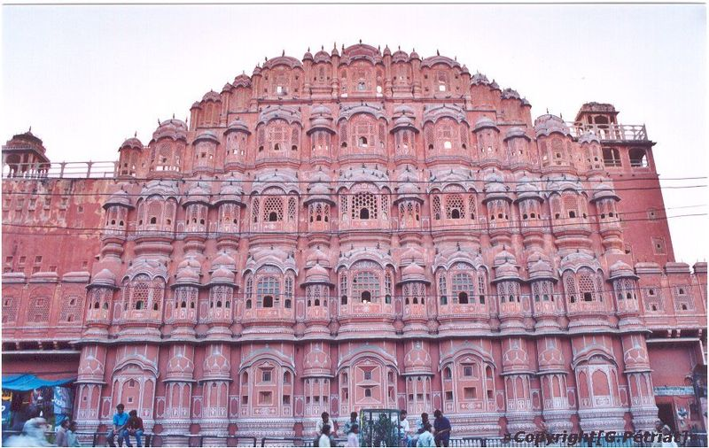
India: Architecture
Lord Bahubali,
11th Cent, Jainism
Halebid,
12th C.,
Sculptures
Church Our Lady of Health, 18th Cent.
Modern Zoroastrian Temple
Hawa Mahal, 18th C., Palace

Slide 20
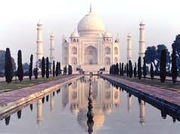
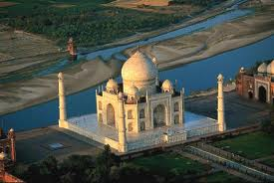
India: Architecture
Taj Mahal built by the Mughal Emperor Shahjahan as a memorial to his wife, Mumtaz Mahal.
Work started in 1634 and continued for almost 22 years.
The Taj Mahal ranks as amongst the most perfect buildings in the world, flawlessly proportionate, built entirely out of marble.

Slide 21
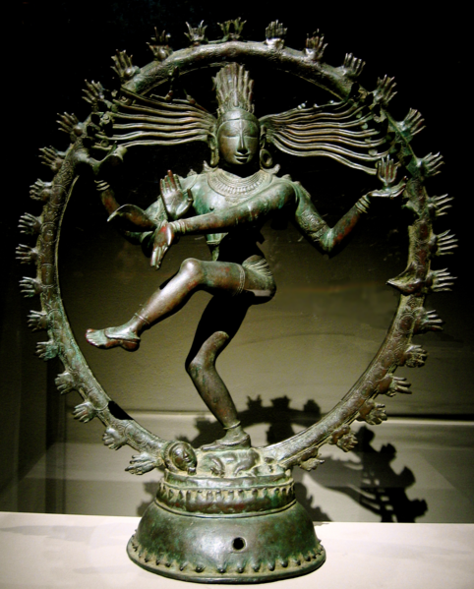
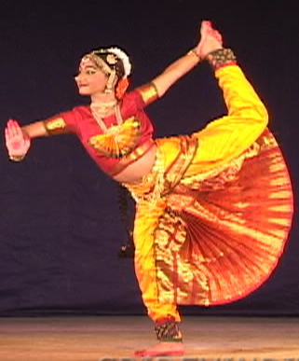
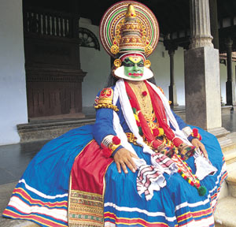
Entertainment: Dance
Traditional
  Bharata Natyam
  Kuchi Pudi
  Katha Kali
Popular Dance
  Movie Dances
  Western Rock & Roll

Slide 22
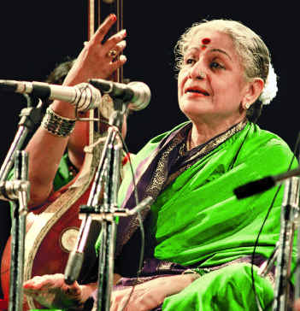
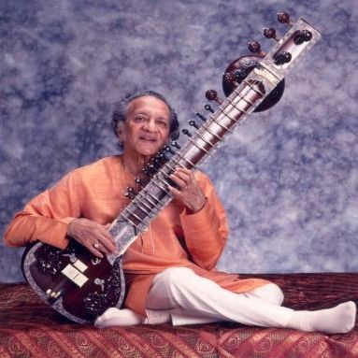
Entertainment: Music
Traditional Music
  Hindustani (North India)
    Vocal
    Instrumental
  Carnatic (South India)
    Vocal
    Instrumental

Slide 23
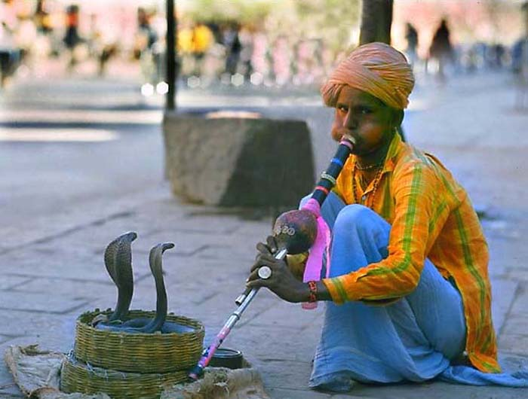
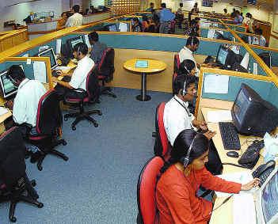
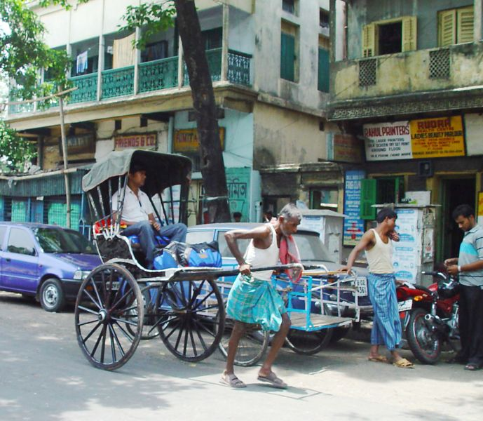

Land of Contrasts

Slide 24

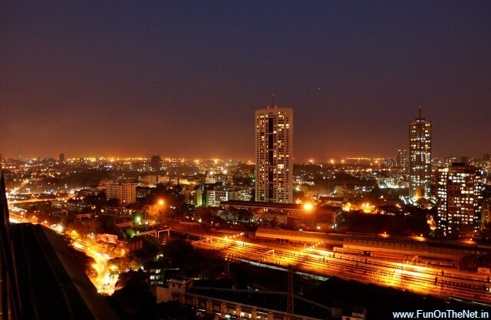

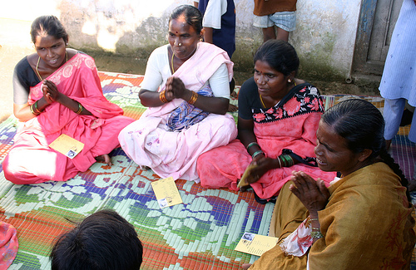
Land of Contrasts

Slide 25
Describing India
A land of contrasts:
“Everything you have heard of India is true. And the opposite is also true”
A visible tangible India
An invisible intangible India
Understanding India’s multicultural society

Slide 26
Contact me …
Resources, websites, ideas, notes will be available online:
www.gdrc.info/sms/
Send me an email anytime!
Hari Srinivas
hari.srinivas@kwansei.ac.jp
IMPORTANT:
When you send an email, please always put “[SMS]” in the subject line!

